Slide 1
Run-time stack for factorial method
Handling method/function calls
When high-level languages are compiled, functions/methods and main routine generate separate blocks of low-level code, each at different locations in memory

Slide 2
JVM (Java Virtual Machine) maintains a run-time stack where it saves information in the form of an activation frame
Activation frame has storage for:
Method arguments
Local variables
Return address of the instruction that called the method
Whenever a method is called, java pushes a new activation frame onto the run-time stack

Slide 3
See stack trace in IntelliJ
The call stack is visible while debugging

Slide 4
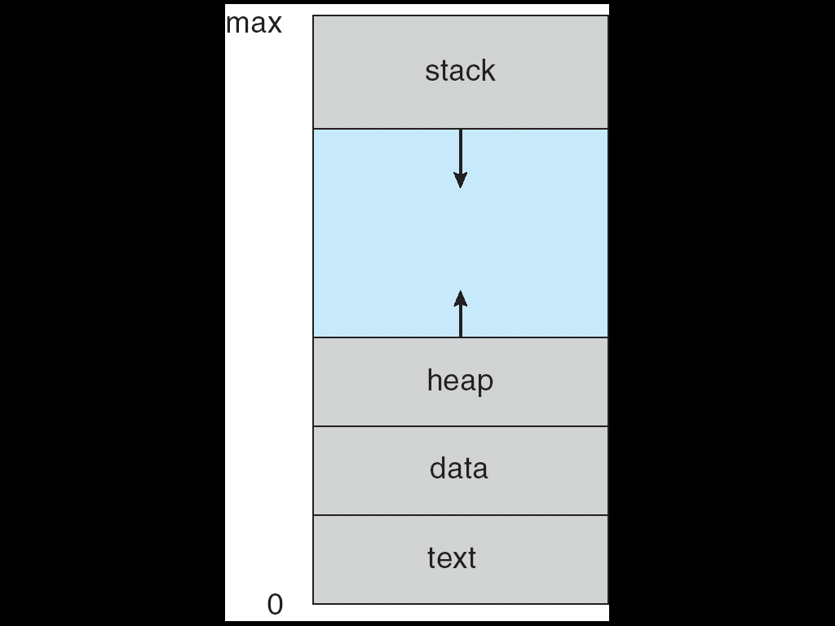
A program (process) in memory

Slide 5
A recursive function to compute factorial is:-
public static int fact(int n)
{
if (n == 1 || n == 0)
return 1;
else
return n * fact(n-1);
}

Slide 6
Consider run-time stack when fact method is called from main() as follows:
int result = fact(5);

Slide 7
Initially on frame on run-time stack
main()

Slide 8
After first call to fact() method
fact(5)
main()

Slide 9
After all recursive calls to fact()method
fact(1)
fact(2)
fact(3)
fact(4)
fact(5)
main()

Slide 10
When fact(1) is executed, there is no further recursion and 1 is returned to previous call i.e fact(2)
one frame is removed from stack:
fact(2)
fact(3)
fact(4)
fact(5)
main()

Slide 11
Then 2* 1 is returned to previous call i.e fact(3)
fact(3)
fact(4)
fact(5)
main()

Slide 12
As each method calls and returns, frames are removed from stack until just main() is left – 120 will have been returned as value of fact(5)
main() will continue to execute – statement after call to fact()is next
main()

